Slide 1
Bangkok Neighborhood Analysis along BTS Sukhumvit Line

Slide 2

Background
Bangkok is one of the mega cities where 10 million people reside. The city occupies 1,568.7 square kilometres and consists of 50 districts with different lifestyles and neighborhoods. The main transportation in Bangkok is by roads which can accommodate only 1.5 million vehicles whereas the city has 9.7 million automobiles and motorbikes combined. This overcapacity has led to multiple issues such as traffic jam, high fuel consumption and air pollution. The average person would spend 207 extra hours per year driving in the rush hours in Bangkok.

Slide 3
Background
The Bangkok Mass Transit System, commonly known as the BTS is an elevated rapid transit system in Bangkok has opened the first line called “Green Line” which consists of:
(1) Silom Line
(2) Sukhumvit Line
In late 1999 to ease the mentioned traffic jam issues on the roads. Currently, this Green Line support around 700 thousand people daily and became the major mass transit system in Bangkok.

Slide 4
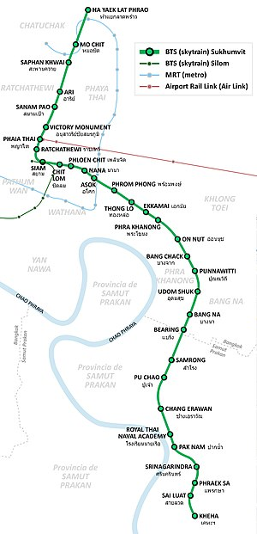
Background
Where is the best place to live?
Scope of this study
BTS Sukhumvit Line
32 Stations
Problem
Find suitable location that has:
Relative low living expenses
Located around the station on BTS Sukhumvit Line within 12 stations away from “Asok Station” (Assume that time commute between station is 5 mins)
Asok
Staion

Slide 5
Source Data Used
Location of Stations along BTS Sukhumvit Line (from: Wikipedia)
FourSquare API: Venues Category and Venues Detail

Slide 6
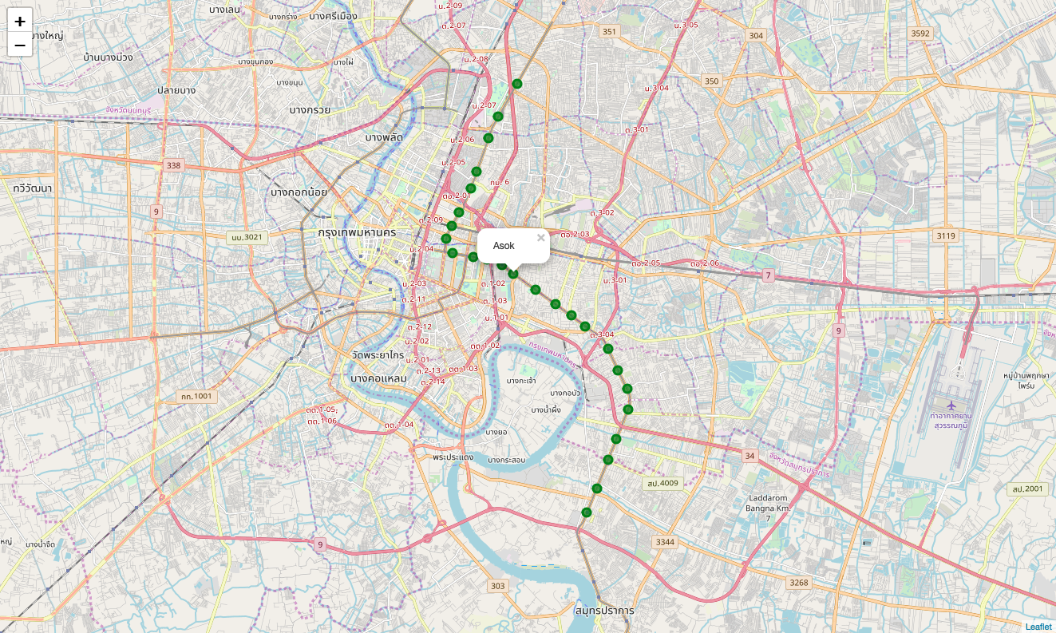
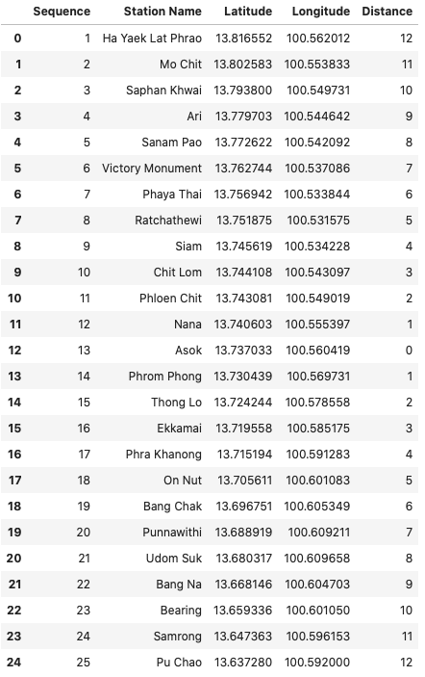
Filter out stations beyond 12 stations from Asok station.

Slide 7
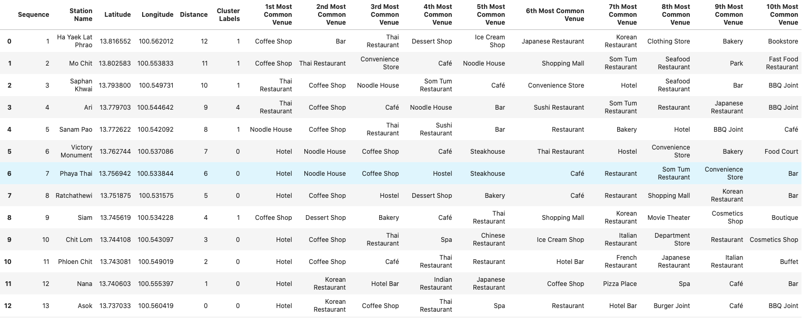
Top 10 venue categories on these stations

Slide 8
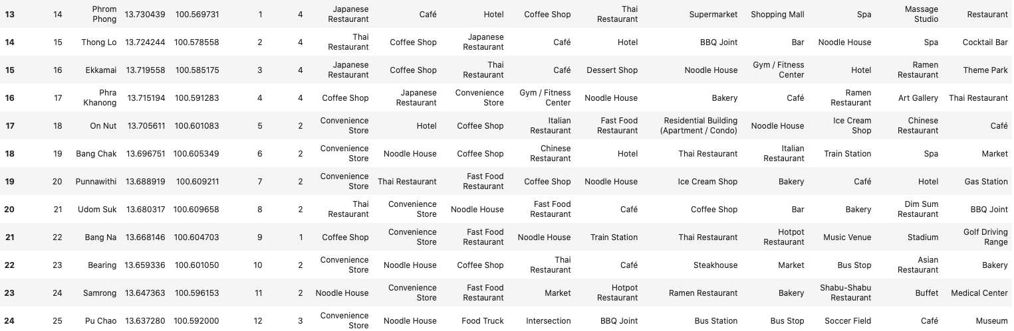
Top 10 venue categories on these stations (Continue)

Slide 9
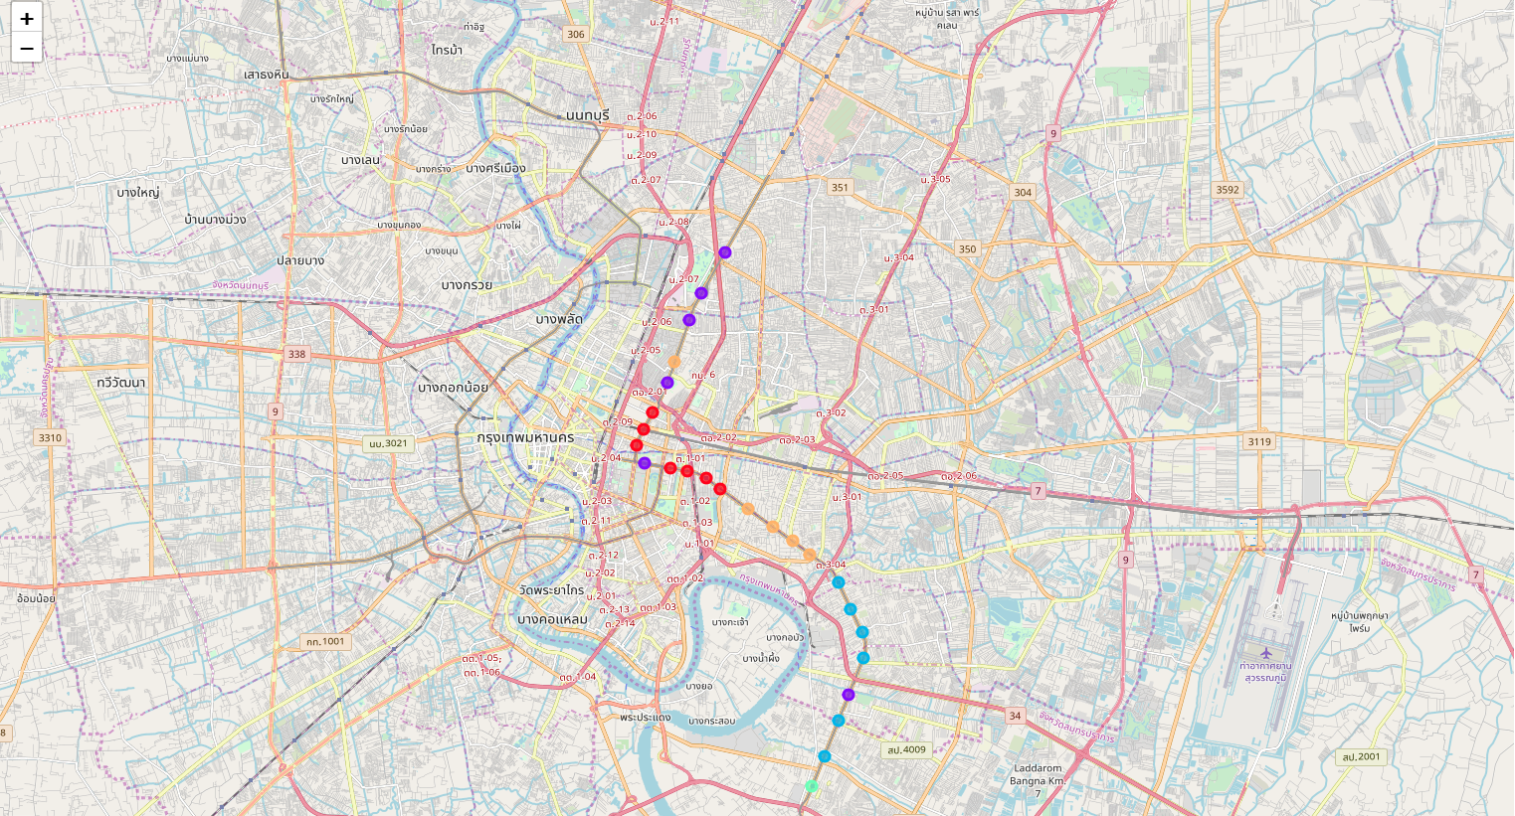
Cluster of Neighborhoods around BTS Sukhumvit Line Stations
Cluster 0
Cluster 1
Cluster 2
Cluster 3
Cluster 4

Slide 10
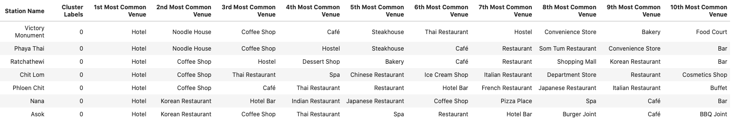
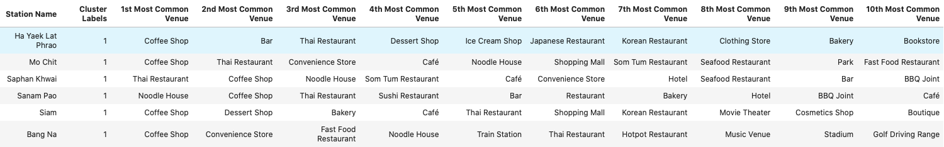
List of each cluster

Slide 11
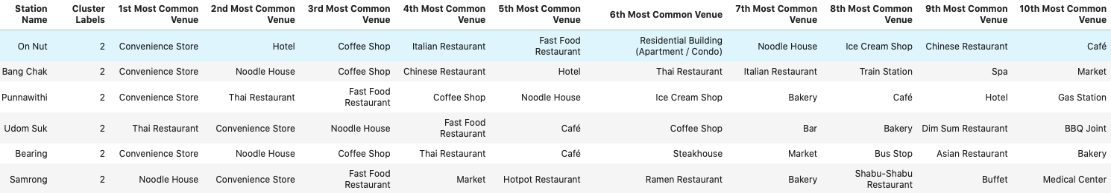

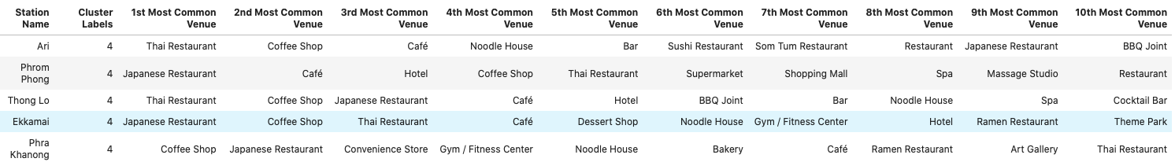
List of each cluster

Slide 12
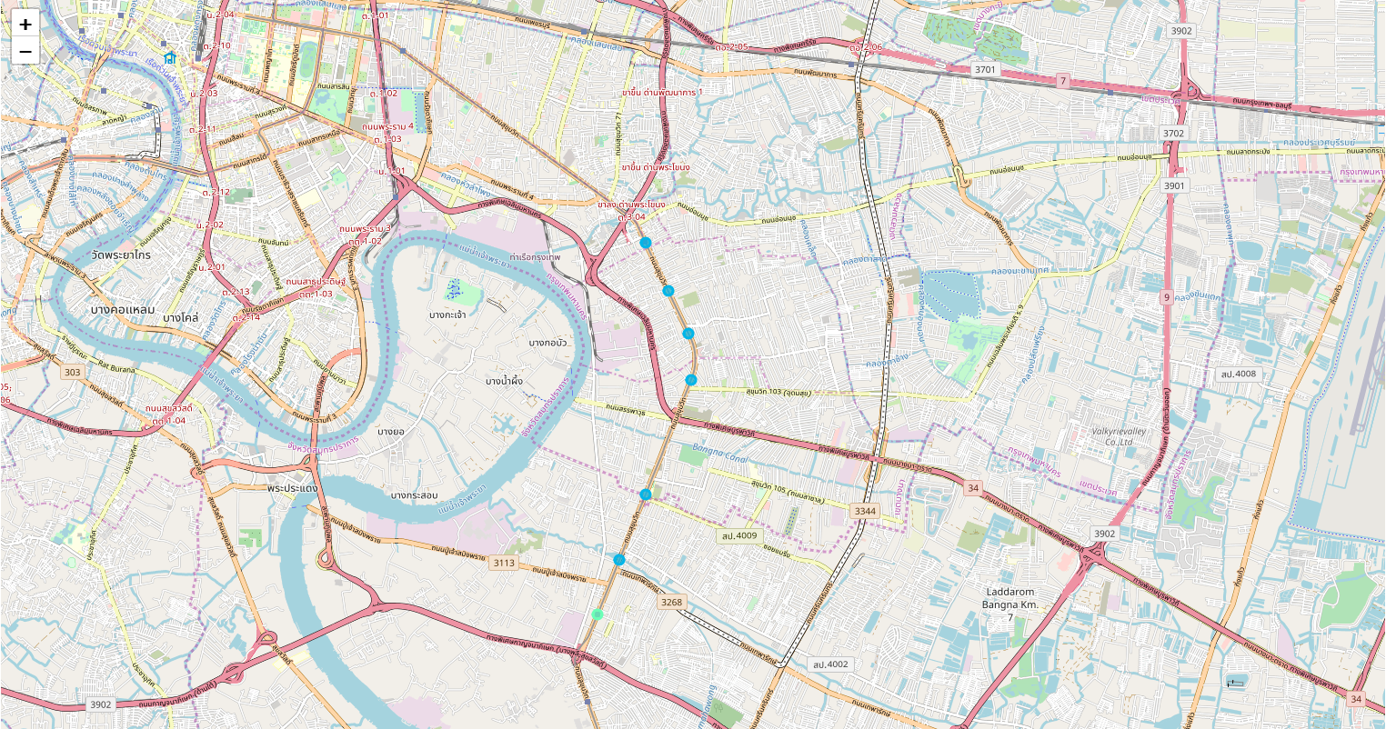
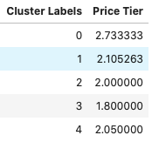
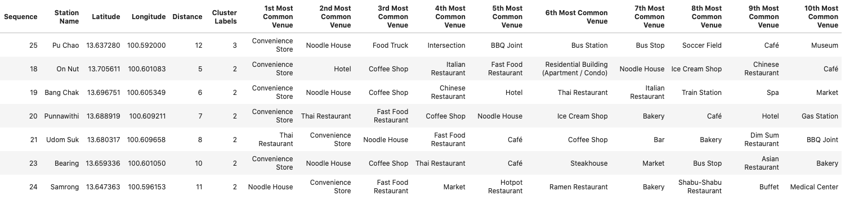
Price Tier of each cluster label on scale of 1-4 * 1 (least pricey) to 4 (most pricey)
Cluster 2
Cluster 3

Slide 13
Observations
FourSquare database seems to focus on some particular categories e.g. Restaurant, Café and doesn’t contain all categories that would provide more inside into neighborhood characteristics. Also, I noticed that their database is not up-to-date, so the venues might not be available and its details might not reflect the reality.
Venues details are not accurate as it’s based on community, so the price tier on the same restaurants may differ between branches.
Not all venue contains price tier which would reduce the sample used to calculate the average of price tier of each cluster
There is a limit on FourSquare Premium API, so I need to utilize it within the quota; however, the results are aligned with the reality.

Slide 14
Recommendations
To go further another step to explore the actual condominiums/apartments. We can use FourSquare API to get their venues’ details such as price tier, rating and tips.
To use different data sources e.g. Property Listing, Real Estate Forums, etc. to get more accurate posting rental for condominiums/apartments which would be more accurate compared to price tier input by community for FourSquare’s venues.
Adding more variables such as crime rates to add more aspects into the location selection model.
Adding more neighborhoods along another mass transit line e.g. BTS Silom Line or MRT Blue Line, etc.

Slide 15
Conclusions
By using FourSquare API, we are able to cluster the neighborhood based on their venues’ categories characteristics by using k-Means Clustering methods into 5 clusters. Based on this clustering, we then assume that the living expenses in the same cluster are not that different. By this assumption, we sample the venues in the same cluster and retrieve the price tier information from FourSquare which we used to represent the living expenses standard in the cluster. By consolidating the result, we are about to filter/select the suitable neighborhood according to our criteria which are neighborhoods around “Pu Chao”, “On Nut”, “Bang Chak”, “Punnawithi”, “Udom Suk”, “Bearing” and “Samrong”

